Slide 1
Instruction Set
& Programming
What are Addressing Modes ?
How many Addressing Modes does 8051 support ?
And what are they ?
What is Assembly language ?
What is 20/80% rule of assembly language programming ?
Snytax of Assembly language.
Explanation of Addressing Modes

Slide 2
5 Addressing Modes
Immediate Addressing Mode
Register Addressing Mode
Direct Addressing Mode
Indirect Addressing Mode
Indexed Addressing Mode

Slide 3
What is Assembly language ?
A low level machine specific abstracted programming language which uses symbolic representations for opcodes & operands for instructions machine codes .
Syntax of Assembly
LABEL: MNEMONIC OPERANDS ; COMMENTS

Slide 4
Categories/groups of Instructions
Data Transfer
Arithematic
Logical
Boolean
Branching

Slide 5
Understanding Addressing Modes using MOV instruction
Syntax:
MOV Destination,Source

Slide 6
Immediate addressing
  The value of a constant can follow the opcode in program memory
  The # sign is the designator of the constant

Slide 7
Options:
MOV A,#data(8-bit)
MOV Rn,#data(8-bit) ; n=0 - 7
MOV DPTR,#data (16-bit)
MOV @Ri,#data(8-bit) ; i=0/1

Slide 8
Register Addressing mode
options :
MOV A,Rn ; n=0 - 7
MOV Rn, A ; n=0 -7

Slide 9
Direct Addressing
  At least one of the operand is specified by an 8 bit address field
  Internal data RAM and SFRs can be directly addressed

Slide 10
Direct Addressing
Options :
MOV Addr,#data(8-bit)
MOV A,Addr
MOV Addr,A
MOV Rn,Addr
MOV Addr,Rn
MOV Addr1,Addr2

Slide 11
Indirect Addressing
  The instruction specifies a register that contains the address of the operand
  Both Internal and External RAM can be indirectly addressed
  Address register can be R0 or R1 of a selected register bank or the SP for 8 bit and DPTR for 16 bit address

Slide 12
Indirect : Internal RAM
options:
MOV @Ri,A ; i=0/1
MOV A,@Ri ; i = 0/1
MOV @Ri,ADDR
MOV ADDR,@Ri

Slide 13
Indirect: External RAM
Notes:
All external data moves must involve A register
Rp,where p=0/1 can address 256 bytes;
DPTR can address 64K bytes
MOVX is normally used with external RAM or I/O address.

Slide 14
Indirect : External
Options:
MOVX @Rp,A ;p=0/1
MOVX A,@Rp ; ”
MOVX @DPTR,A
MOVX A,@DPTR

Slide 15
Indexed Addressing ONLY for:
Code Memory Read
Options:
MOVC A,@A + DPTR
MOVC A,@A + PC

Slide 16
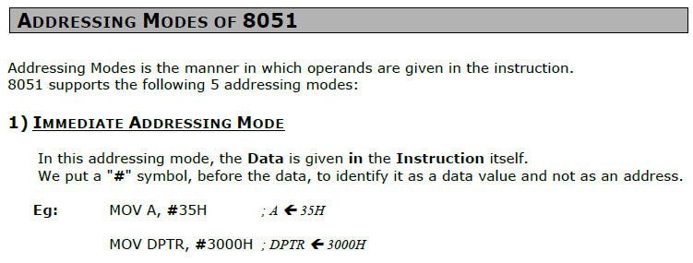
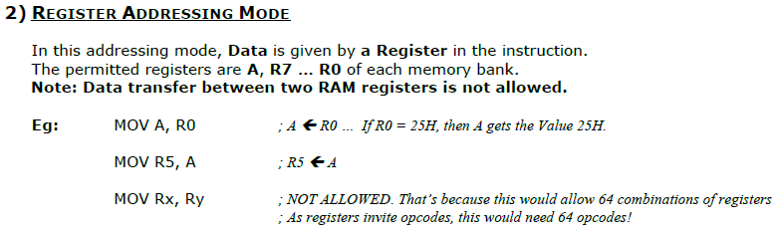

Slide 17
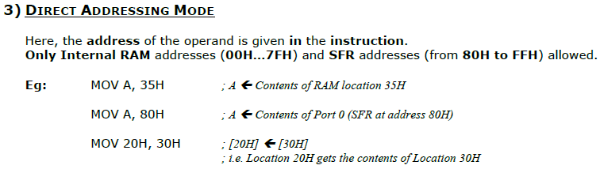
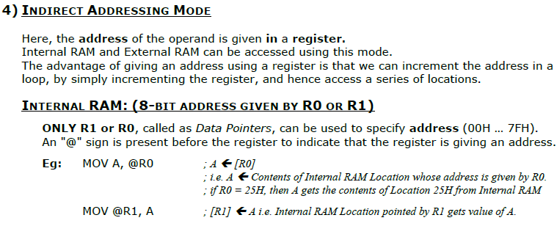

Slide 18
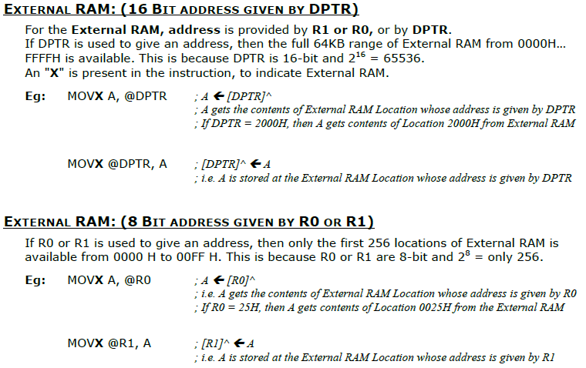

Slide 19
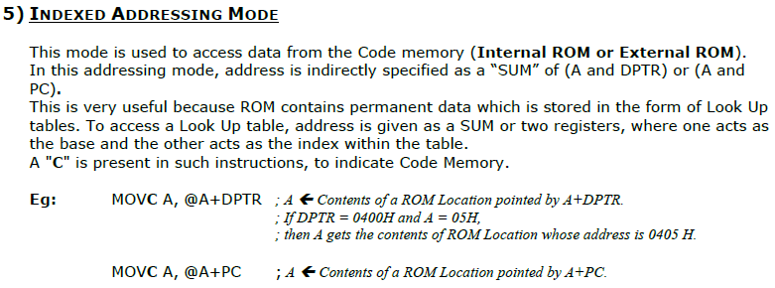

Slide 20
END of ADDRESSING MODES Discussion

Slide 21
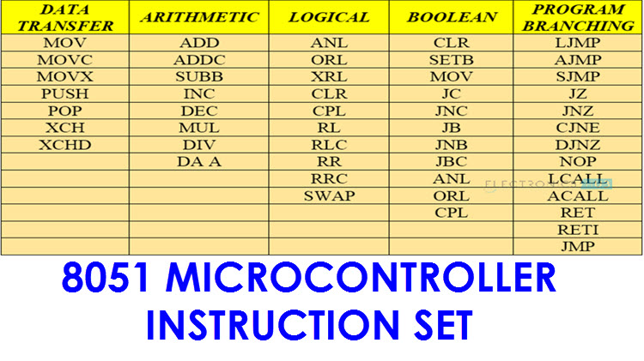

Slide 22
Data Transfer Instruction Set
Continued

Slide 23
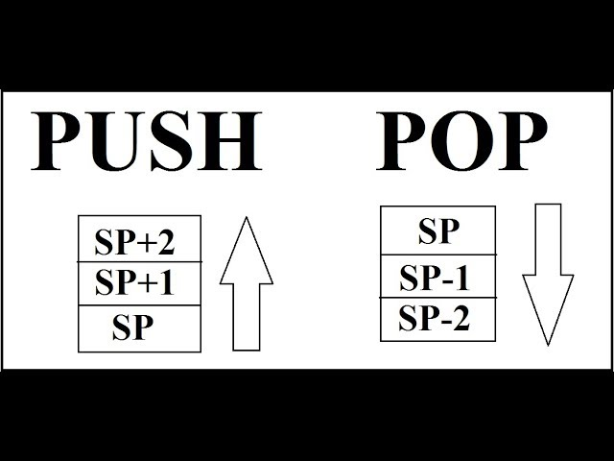
Push and Pop opcodes
PUSH Addr
POP Addr

Slide 24
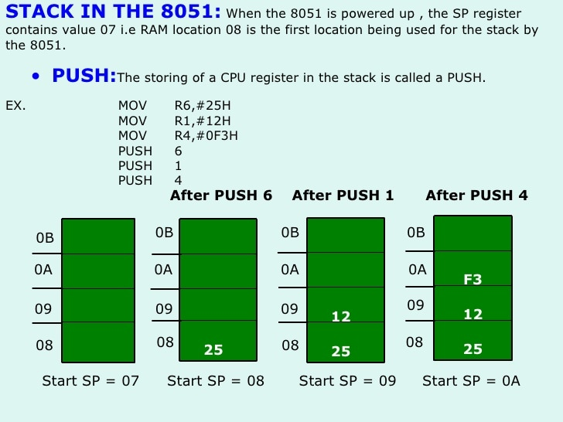

Slide 25
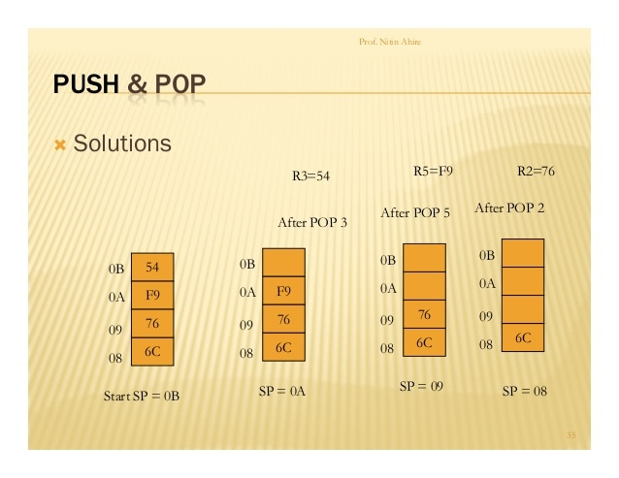

Slide 26
Notes
When SP reaches FFh, it rolls over to 00h
PUSHes above 7Fh result in error
Only direct addresses MUST be used as operands
But PUSH & POP use indirect addressing

Slide 27
Data Exchanges
Move data in two directions
XCH A, Rn
XCH A, addr
XCH A,@Ri
XCHD A, @Ri

Slide 28
Notes
All exchanges are internal to 8051
All exchanges use register A
When using XCHD, the upper nibbles are not exchanged

